Slide 1
From clouds to cores to envelopes to disks a multi-scale view of magnetized star formation
Chat Hull
University of California, Berkeley
Radio Astronomy Laboratory
18 October 2013
Harvard/CfA RG Lunch Talk
Cambridge, Mass.
Notes:
Star formation regions

Slide 2
Outline
Magnetized star formation
B-fields vs. outflows: multi-scale comparisons
Outflows/jets/disks and B-fields are randomly aligned (or perhaps ⟂?)
TADPOL survey
CARMA 1mm full-Stokes polarization system
B-fields: multi-scale comparisons
Cloud → core → envelope → disk
Two populations of cores: high and low polarization fraction
Back to outflows!
Disk formation implications
Star-forming regions

Slide 3
Scales of star formation
> 1 pc
0.1 pc
1000 AU
< 100 AU
cloud
core
envelope
disk

Slide 4
Outline
Magnetized star formation
B-fields vs. outflows: multi-scale comparisons
Outflows/jets/disks and B-fields are randomly aligned (or perhaps ⟂?)
TADPOL survey
CARMA 1mm full-Stokes polarization system
B-fields: multi-scale comparisons
Cloud → core → envelope → disk
Two populations of cores: high and low polarization fraction
Back to outflows!
Disk formation implications
Star-forming regions

Slide 5
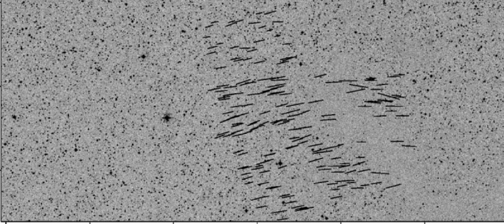
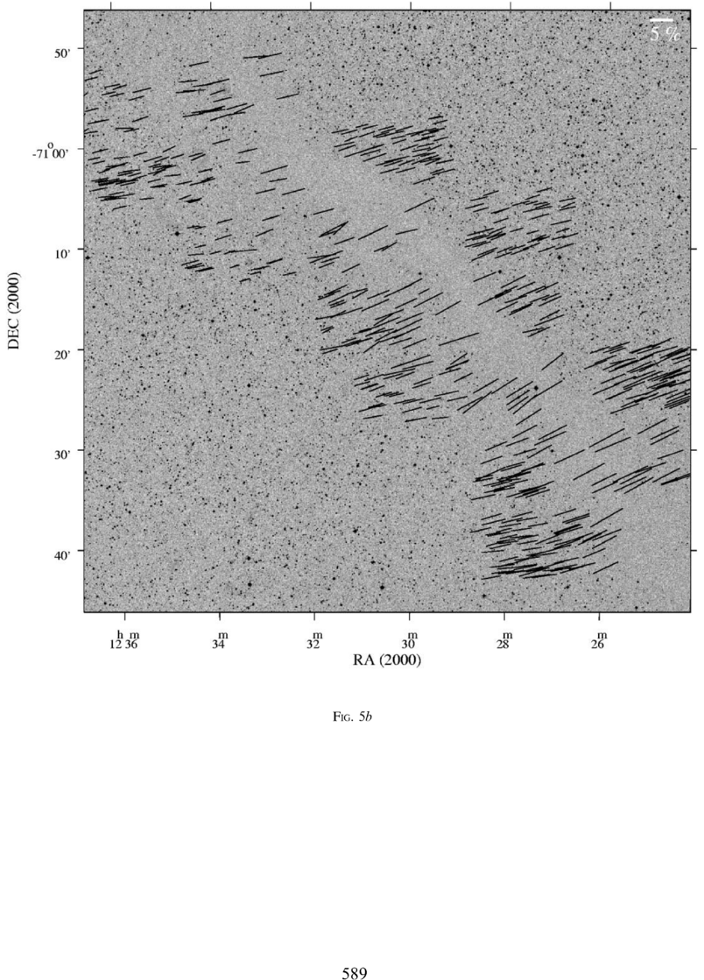
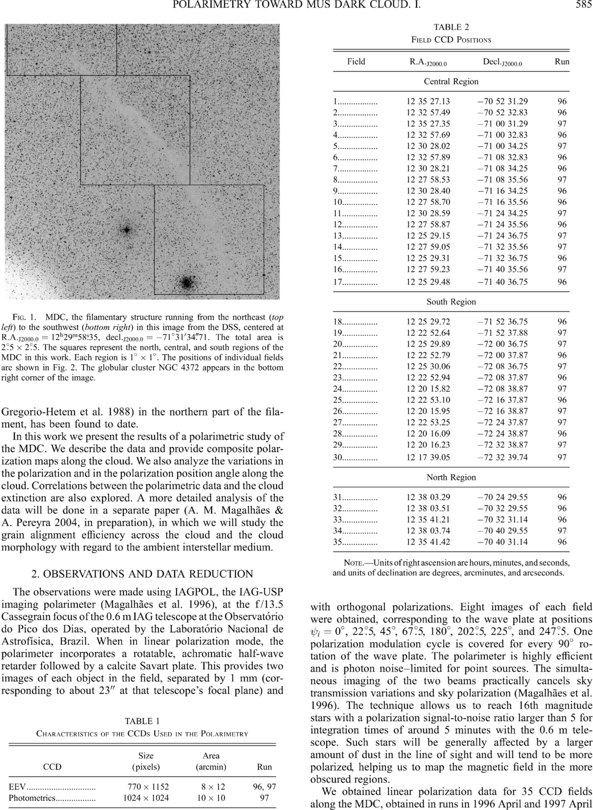
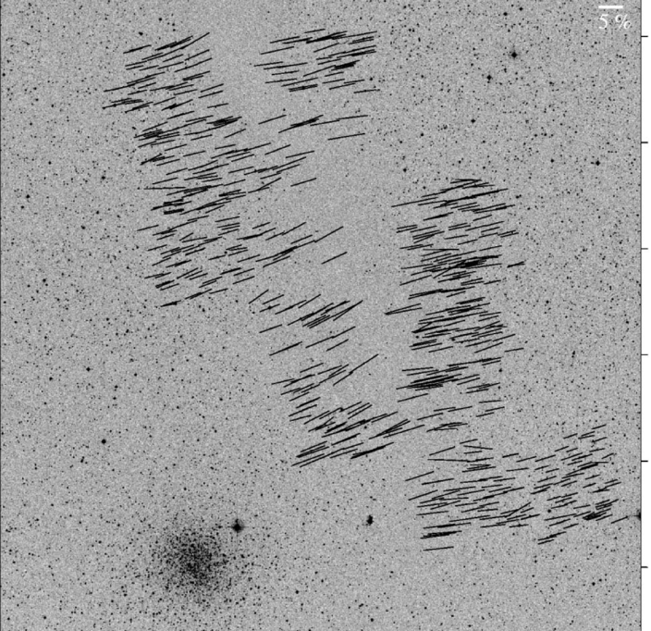
Large-scale: ordered fields
Musca dark cloud
10 pc
E,B
Pereyra & Magalhães 2004
Notes:
-Distance: 250 pc
-Mass: 250 solar masses
-Length ~10 pc

Slide 6


What is the role of magnetic fields in star formation?
Incidental?
Fundamental?

Slide 7
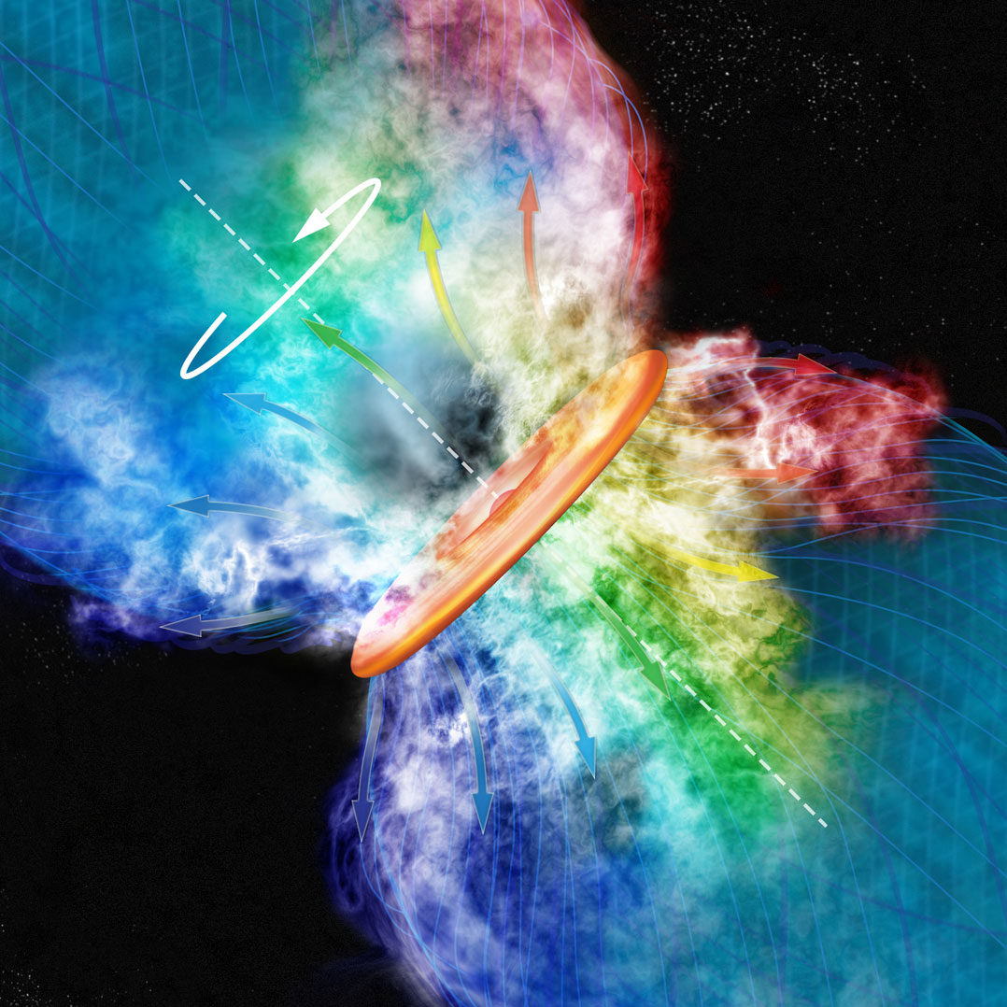
Credit: Bill Saxton, CfA

Slide 8
Outline
Magnetized star formation
B-fields vs. outflows: multi-scale comparisons
Outflows/jets/disks and B-fields are randomly aligned (or perhaps ⟂?)
TADPOL survey
CARMA 1mm full-Stokes polarization system
B-fields: multi-scale comparisons
Cloud → core → envelope → disk
Two populations of cores: high and low polarization fraction
Back to outflows!
Disk formation implications
Star-forming regions

Slide 9
Multi-scale comparisons: B-fields vs. outflows
1 pc
0.1 pc
1000 AU
100 AU
RANDOM
Ménard & Duchêne 2004
Targon+ 2011

Slide 10
Misalignment of B-fields and disks/jets
Comparing orientations of large-scale B-field with disks/jets in T Tauri stars
1
Ménard & Duchêne 2004
Cumulative Distribution Function (CDF)
0
0º
90º
𝜽_{disk/jet} – 𝜽_{B-field} (deg)
10 pc

Slide 11
Misalignment of B-fields and disks/jets
1
CDF
~1 pc
Targon+ 2011
0
0º
𝜽_{jet} – 𝜽_{B-field} (deg)
90º

Slide 12
Multi-scale comparisons: B-fields vs. outflows
1 pc
0.1 pc
1000 AU
100 AU
RANDOM
Ménard & Duchêne 2004
Targon+ 2011

Slide 13
Multi-scale comparisons: B-fields vs. outflows
1 pc
0.1 pc
1000 AU
100 AU
RANDOM
Curran & Chrysostomou 2007

Slide 14
Misalignment of B-fields and outflows
Comparing B-fields with outflows on the core (~0.1 pc) scale
B
CDF
~0.25 pc
Curran & Chrysostomou 2007
𝜽_{outflow} – 𝜽_{B-field} (deg)

Slide 15
Multi-scale comparisons: B-fields vs. outflows
1 pc
0.1 pc
1000 AU
100 AU
RANDOM
Curran & Chrysostomou 2007

Slide 16
Multi-scale comparisons: B-fields vs. outflows
1 pc
0.1 pc
1000 AU
100 AU
RANDOM
Or preferentially ⟂ ?
Hull+ 2013a

Slide 17
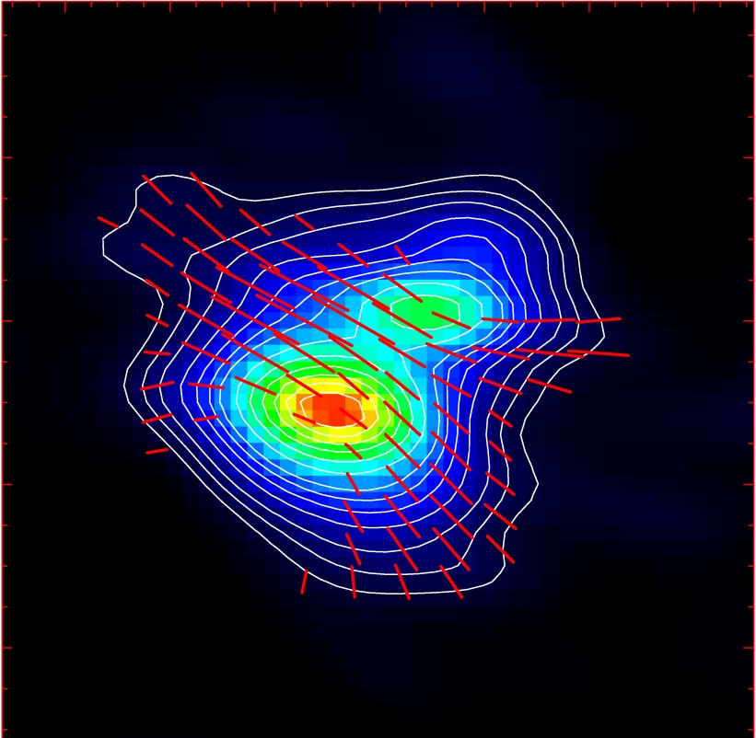
Misalignment of B-fields and outflows
IRAS 16293
NGC 1333-IRAS 4A
B-field
Rao+ 2009
Girart+ 2006
Outflow
Notes:
ROTATION: IRAS 16293 has rot/grav < 0.1; IRAS4A seems the same (barely any rotation); VLA 1623 questionable (probably slow)
-Holland: JCMT data
-Rao, Girart: SMA
-This is okay, according to Hennebelle & Ciardi ‘09 (easier to form disks with obliquity!)
-Ward-Thompson et al (2009) saw a 30 deg offset between short axes of cores and their polarization directions…another problem!

Slide 18
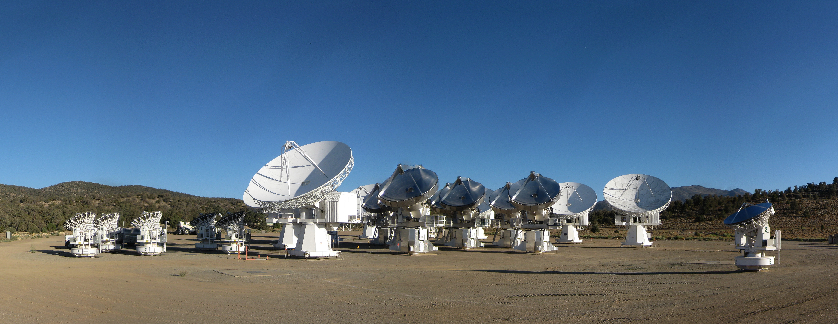
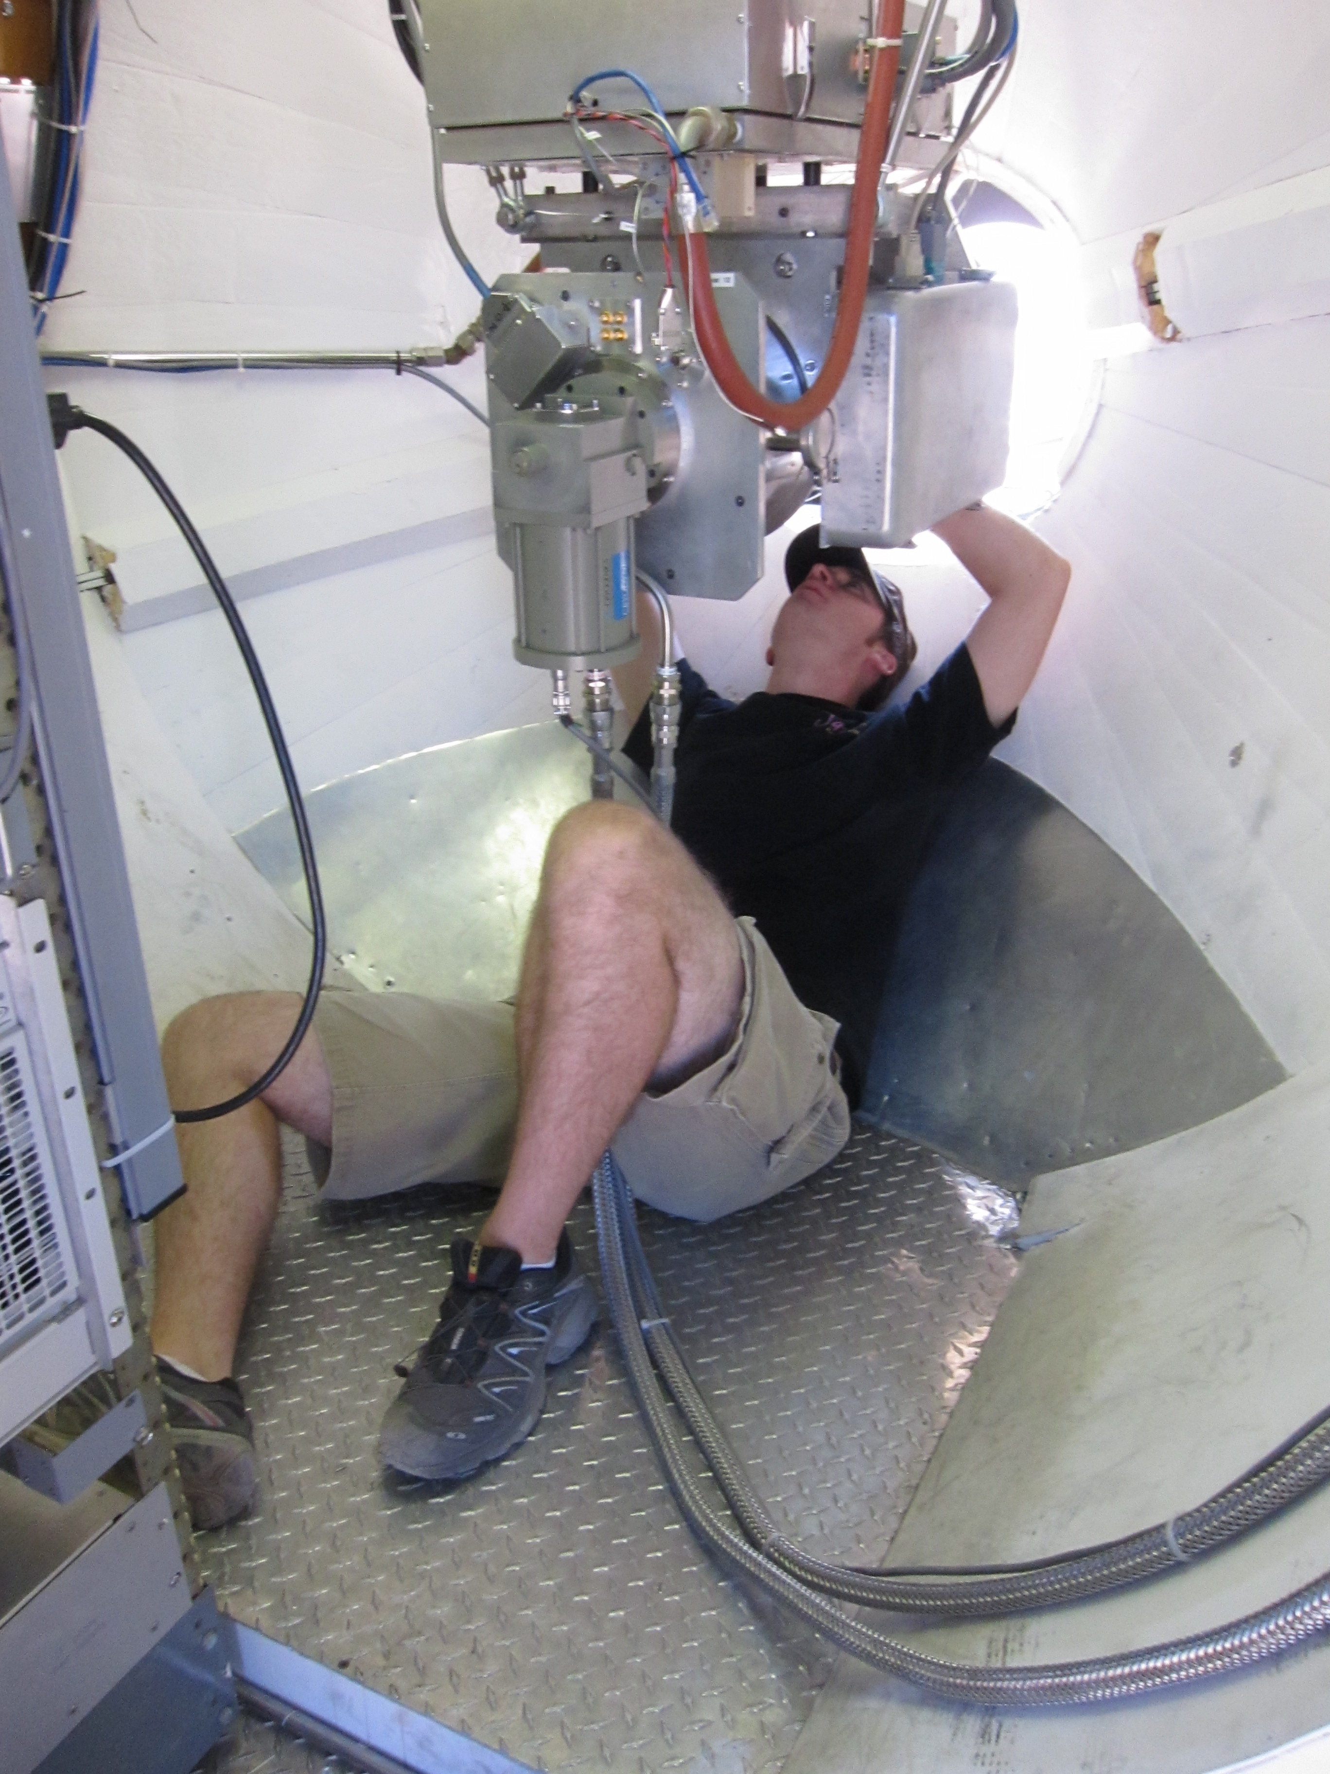
CARMA Combined Array for Research in Millimeter-wave Astronomy Consortium: Berkeley, Caltech, Illinois, Maryland, Chicago
6 ⨯10-m, 9 ⨯ 6-m, and 8 ⨯ 3.5-m telescopes
Observations at 1 cm, 3 mm, and
1 mm (polarization!)
Located in Cedar Flat, CA (near Bishop)
Notes:
SMA: 8*6m antennas = 226 m^2
CARMA: 6*10m, 9*6m = 726 m^2 (more than factor of 3 more area)
-Factor of two more dishes
-Equivalent T_sys?

Slide 19
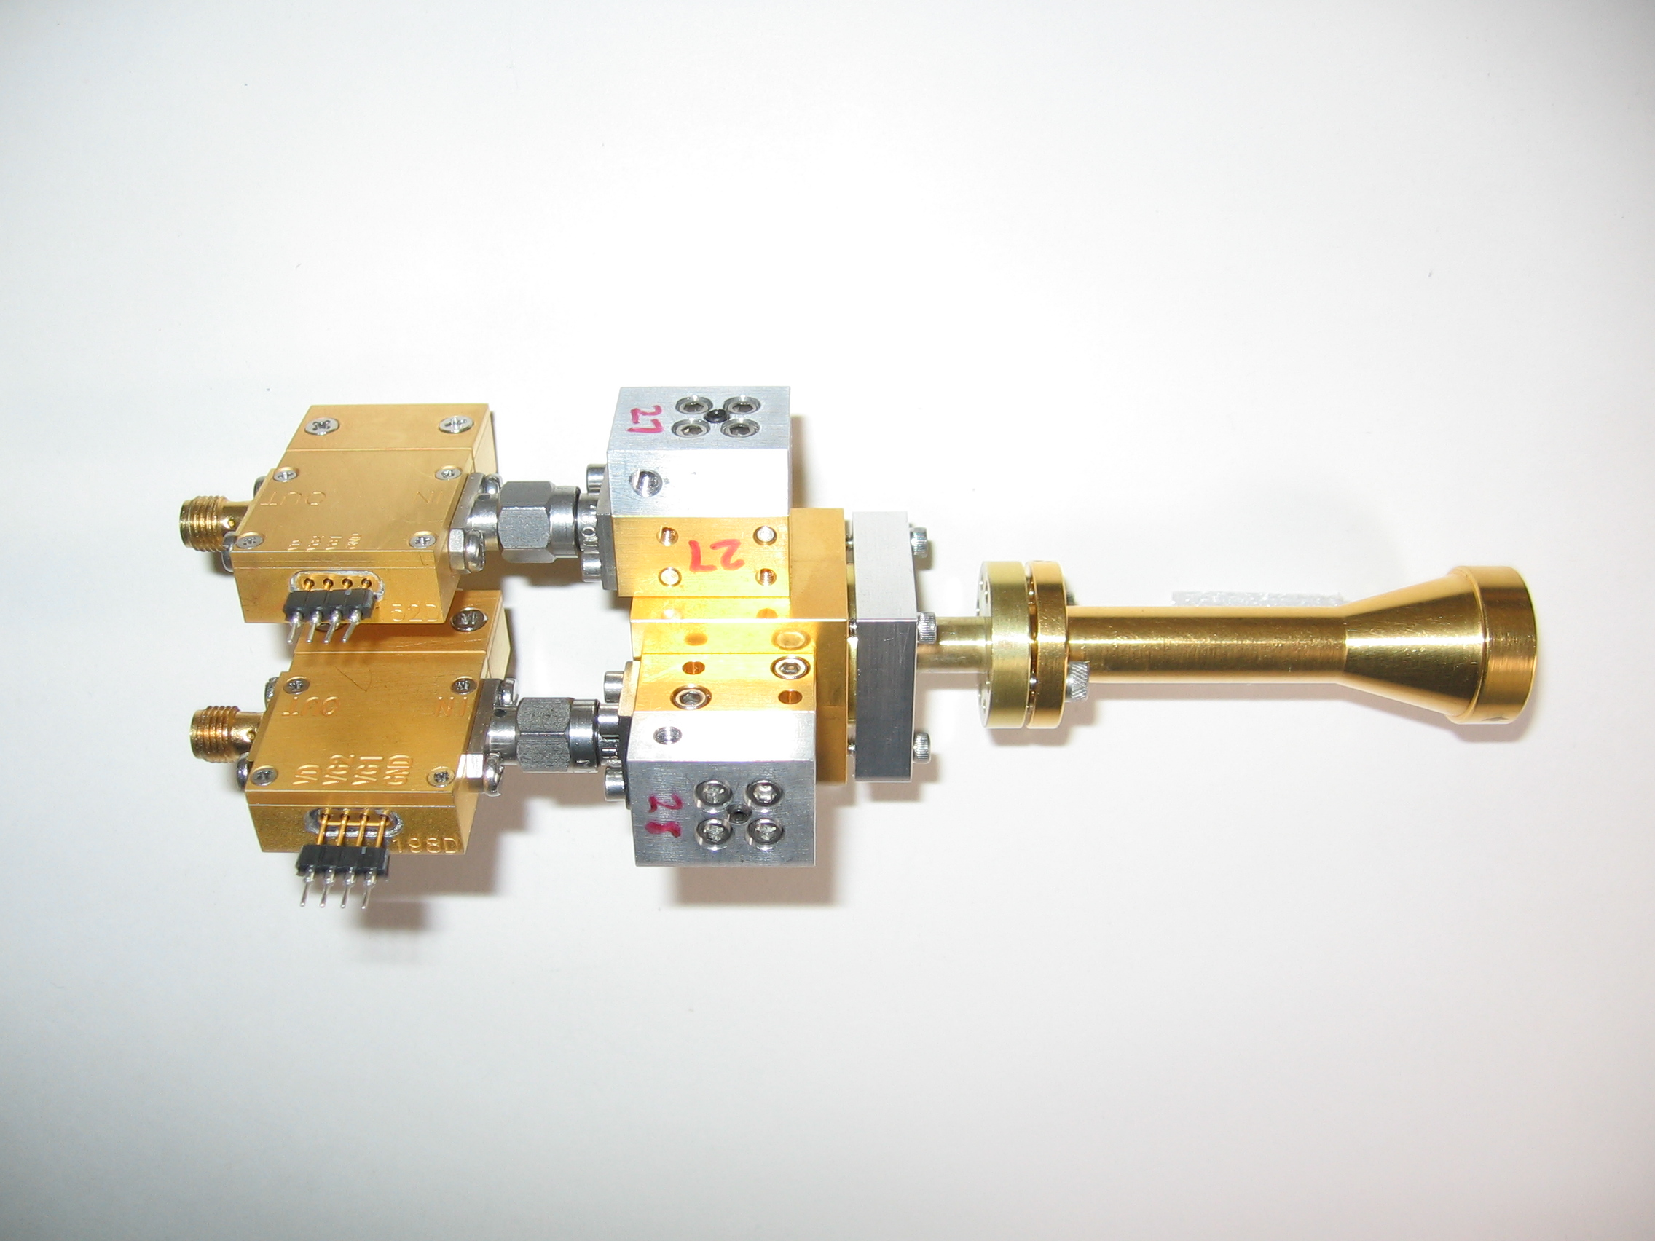
1 mm dual-polarization receivers
SIS mixers
Orthomode transducer
Waveguide circular polarizer
1 inch
WBA13
I.F. amplifiers (1-9 GHz)
Credit: Dick Plambeck
Notes:
-Sensitive to RCP & LCP
-Null experiment: in the absence of linear polarization, you get no RL correlation at any time.
-If you have linear feeds, you have XY correlation sometimes (when the intrinsic polarization is at 45º to your two feeds), and not other times (when it’s along one feed or the other). Thus, to tease out the polarization, you need stable gains

Slide 20
Misalignment of B-fields and outflows
IRAS 16293
NGC 1333-IRAS 4A
B-field
Rao+ 2009
Girart+ 2006
Outflow
Notes:
ROTATION: IRAS 16293 has rot/grav < 0.1; IRAS4A seems the same (barely any rotation); VLA 1623 questionable (probably slow)
-Holland: JCMT data
-Rao, Girart: SMA
-This is okay, according to Hennebelle & Ciardi ‘09 (easier to form disks with obliquity!)
-Ward-Thompson et al (2009) saw a 30 deg offset between short axes of cores and their polarization directions…another problem!

Slide 21
TADPOL survey

Slide 22
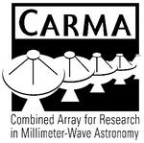














TADPOL collaboration
UC Berkeley
Chat Hull (PI), Dick Plambeck, Mel Wright, Carl Heiles, Geoff Bower
University of Maryland
Marc Pound, Alberto Bolatto, Katherine Jameson,
Lee Mundy
Caltech
Thushara Pillai, John Carpenter, James Lamb,
Nikolaus Volgenau
University of Illinois, Urbana-Champagne
Leslie Looney, Dick Crutcher, Nick Hakobian
Other
Dan Marrone (Arizona), Meredith Hughes (Wesleyan), John Vaillancourt & Göran Sandell (USRA-SOFIA), John Tobin (NRAO), Ian Stephens (BU), Jason Fiege & Erica Franzmann (Manitoba), Martin Houde (UWO, Caltech), Brenda Matthews (NRC-CNRC), Woojin Kwon (SRON)

Slide 23
TADPOL survey
37 sources
Largest survey of star-forming cores to date
>500 observing hours
CARMA C, D, & E arrays
1 – 4" resolution
10⨉ higher resolution than CSO & JCMT
Probes intermediate region between ~0.1 pc (single-dish)
and ~100 AU (ALMA)

Slide 24
TADPOL results
L1157
2″
See also: Stephens+ 2013, ApJL, 769, L15
Notes:
NEARBY SF regions:
-Perseus (NGC 1333, L1448, SVS13): 235 pc (masers in SVS13) → 03:30 LST
-Taurus (DG Tau, L1527): 140 pc → 04:30 LST
-Orion: 400 pc → 05:30 LST
-Serpens: 415 pc → 18:30 LST
-Ophiuchus: 140 pc → 17:00 LST
-Cepheus (L1157): 250 pc → 22:00 LST
-Isolated (B335, Bok globule): 250 pc

Slide 25
Credit: Bill Saxton, CfA

Slide 26
TADPOL results
NGC 1333-IRAS 4A
NGC 1333-IRAS 4B, 4B2
2″
2″
Notes:
NEARBY SF regions:
-Perseus (NGC 1333, L1448, SVS13): 235 pc (masers in SVS13) → 03:30 LST
-Taurus (DG Tau, L1527): 140 pc → 04:30 LST
-Orion: 400 pc → 05:30 LST
-Serpens: 415 pc → 18:30 LST
-Ophiuchus: 140 pc → 17:00 LST
-Cepheus (L1157): 250 pc → 22:00 LST
-Isolated (B335, Bok globule): 250 pc

Slide 27
TADPOL results
L1527
NGC 1333-IRAS 2A
2″
3″
Notes:
NEARBY SF regions:
-Perseus (NGC 1333, L1448, SVS13): 235 pc (masers in SVS13) → 03:30 LST
-Taurus (DG Tau, L1527): 140 pc → 04:30 LST
-Orion: 400 pc → 05:30 LST
-Serpens: 415 pc → 18:30 LST
-Ophiuchus: 140 pc → 17:00 LST
-Cepheus (L1157): 250 pc → 22:00 LST
-Isolated (B335, Bok globule): 250 pc

Slide 28
TADPOL results
Ser-emb 8, 8(N)
3″
Notes:
NEARBY SF regions:
-Perseus (NGC 1333, L1448, SVS13): 235 pc (masers in SVS13) → 03:30 LST
-Taurus (DG Tau, L1527): 140 pc → 04:30 LST
-Orion: 400 pc → 05:30 LST
-Serpens: 415 pc → 18:30 LST
-Ophiuchus: 140 pc → 17:00 LST
-Cepheus (L1157): 250 pc → 22:00 LST
-Isolated (B335, Bok globule): 250 pc

Slide 29
Outflow vs. B-field: distribution
Simulation: outflows & B-fields aligned within a 20º cone (tightly aligned)
1
0 – 20º
Simulation: outflows & B-fields are randomly oriented
CDF
Simulation: outflows & B-fields aligned between 70–90º (preferentially misaligned)
Random
70 – 90º
KS-test results:
20º cone ruled out ( p-value ~ 10⁻¹⁵ )
Misaligned ( 0.33 ) and random ( 0.33 ) cannot be ruled out
Hull+ 2013a, ApJ, 768, 159
(plot updated Aug ‘13)
0
0º
90º
𝜽_{outflow} – 𝜽_{B-field} (deg)

Slide 30
Outline
Magnetized star formation
B-fields vs. outflows: multi-scale comparisons
Outflows/jets/disks and B-fields are randomly aligned (or perhaps ⟂?)
TADPOL survey
CARMA 1mm full-Stokes polarization system
B-fields: multi-scale comparisons
Cloud → core → envelope → disk
Two populations of cores: high and low polarization fraction
Back to outflows!
Disk formation implications
Star-forming regions

Slide 31
Multi-scale comparisons: B-fields
> 1 pc
0.1 pc
1000 AU
100 AU
CONSISTENT
Hua-bai Li+ 2009

Slide 32
Large → medium scale Consistent B-field in clouds & cores
E,B
~0.3 pc
E
B
H.-b. Li+ 2009
Sub-mm CSO data
n ~ 10⁵ cm⁻³
L ~ 0.3 pc
Optical data
n ~ 1 cm⁻³
L ~ 100 pc
Notes:
Orion Molecular Cloud region
-Optical polarimetry data: blue vectors
-Huge grey vectors: average of all blue vectors
-IRAS data: just to guide the eye (background image)
-CSO data: dust emission
-White vectors: average of CSO dust polarization
-ALL orientations are B-field directions
-Comparing with simulations, they find that a super-Alfvénic cloud (more turbulence than magnetic support) doesn’t fit well

Slide 33
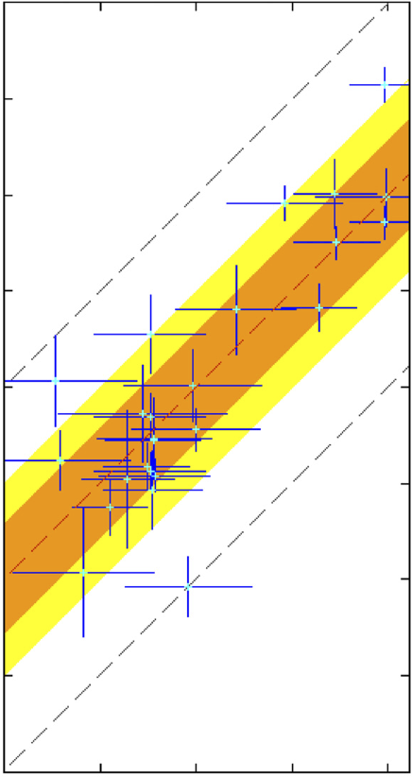
Large → medium scale: Consistent B-fields
Ambient 𝜽_{B-field} (deg) (deg)
0º
90º
180º
90º
Core 𝜽_{B-field} (deg)
0º
Li+ 2009
-90º
H.-b. Li+ 2009
Notes:
Orion Molecular Cloud region
-Optical polarimetry data: blue vectors
-Huge grey vectors: average of all blue vectors
-IRAS data: just to guide the eye (background image)
-CSO data: dust emission
-White vectors: average of CSO dust polarization
-ALL orientations are B-field directions
-Comparing with simulations, they find that a super-Alfvénic cloud (more turbulence than magnetic support) doesn’t fit well

Slide 34
Multi-scale comparisons: B-fields
> 1 pc
0.1 pc
1000 AU
100 AU
CONSISTENT
Hua-bai Li+ 2009

Slide 35
Multi-scale comparisons: B-fields
1 pc
0.1 pc
1000 AU
100 AU
(Not always) consistent
Hull+ 2013b (in prep)
Chapman+ 2013

Slide 36
Cores with consistent large-to-small B-fields
NGC 1333-IRAS 4A
Notes:
Other TADPOL future possibilities:
Intrinsic modeling of B-fields in cores (Fiege)
Constraints on B-fields in protoplanetary disks (Hughes)
Turbulence power spectra (Houde)
Larger scale background-star maps (Mimir, Jameson/Pillai/Clemens)

Slide 37
Cores with consistent large-to-small B-fields
NGC 1333-IRAS 4A
Notes:
Other TADPOL future possibilities:
Intrinsic modeling of B-fields in cores (Fiege)
Constraints on B-fields in protoplanetary disks (Hughes)
Turbulence power spectra (Houde)
Larger scale background-star maps (Mimir, Jameson/Pillai/Clemens)

Slide 38
Cores with consistent large-to-small B-fields
HH 211
Notes:
Other TADPOL future possibilities:
Intrinsic modeling of B-fields in cores (Fiege)
Constraints on B-fields in protoplanetary disks (Hughes)
Turbulence power spectra (Houde)
Larger scale background-star maps (Mimir, Jameson/Pillai/Clemens)

Slide 39
Cores with consistent large-to-small B-fields
HH 211
Notes:
Other TADPOL future possibilities:
Intrinsic modeling of B-fields in cores (Fiege)
Constraints on B-fields in protoplanetary disks (Hughes)
Turbulence power spectra (Houde)
Larger scale background-star maps (Mimir, Jameson/Pillai/Clemens)

Slide 40
Cores with INconsistent large-to-small B-fields
Ser-emb 6
Notes:
Other TADPOL future possibilities:
Intrinsic modeling of B-fields in cores (Fiege)
Constraints on B-fields in protoplanetary disks (Hughes)
Turbulence power spectra (Houde)
Larger scale background-star maps (Mimir, Jameson/Pillai/Clemens)

Slide 41
Cores with INconsistent large-to-small B-fields
Ser-emb 6
See also: Chapman+13
Notes:
Other TADPOL future possibilities:
Intrinsic modeling of B-fields in cores (Fiege)
Constraints on B-fields in protoplanetary disks (Hughes)
Turbulence power spectra (Houde)
Larger scale background-star maps (Mimir, Jameson/Pillai/Clemens)

Slide 42
Cores with INconsistent large-to-small B-fields
L1527
Notes:
Other TADPOL future possibilities:
Intrinsic modeling of B-fields in cores (Fiege)
Constraints on B-fields in protoplanetary disks (Hughes)
Turbulence power spectra (Houde)
Larger scale background-star maps (Mimir, Jameson/Pillai/Clemens)

Slide 43
Cores with INconsistent large-to-small B-fields
L1527
Notes:
Other TADPOL future possibilities:
Intrinsic modeling of B-fields in cores (Fiege)
Constraints on B-fields in protoplanetary disks (Hughes)
Turbulence power spectra (Houde)
Larger scale background-star maps (Mimir, Jameson/Pillai/Clemens)

Slide 44
Cores: B-field consistency
1
0 – 20º
0 – 45º
CDF
Random
ALL CORES
(consistent fields?)
0
Hull+ 2013b (in prep)
0º
𝜽_{small} – 𝜽_{large} (deg)
90º

Slide 45
Alignment vs. polarization fraction
• Core
⨉ Star-forming region
90º
Hull+ 2013b (in prep)
LO-POL
𝜽_{small} – 𝜽_{large} (deg)
45º
HI-POL
0º
Polarization %
1%
7%

Slide 46
Cores: two populations
HI-POL
(P ≈ 3 – 6%)
LO-POL
(P ≲ 3%)

Slide 47
Polarization “hole” effect
L1157
10%
HIGH %
Polarization %
LOW %
0%

Slide 48
Cores: two populations
HI-POL
(P ≈ 3 – 6%)
B_{sm} ∥B_{lg}
Outflows random w.r.t. B_{sm}
LO-POL
(P ≲ 3%)
B_{sm} ∦ B_{lg}
Outflows ⟂ B_{sm}

Slide 49
Multi-scale comparisons: B-fields vs. outflows
1 pc
0.1 pc
1000 AU
100 AU
Back to outflows!
RANDOM
Hull+ 2013a

Slide 50
Multi-scale comparisons: B-fields vs. outflows
1 pc
0.1 pc
1000 AU
100 AU
RANDOM
Or preferentially ⟂ ?
Hull+ 2013a

Slide 51
Multi-scale comparisons: B-fields vs. outflows
1 pc
0.1 pc
1000 AU
100 AU
Random (HI-POL)
⟂ (LO-POL)

Slide 52
Cores: B-field vs. outflow alignment
1
0 – 20º
0 – 45º
CDF
Random
ALL CORES
(random/misaligned?)
70 – 90º
0
Hull+ 2013b (in prep)
0º
𝜽_{outflow} – 𝜽_{B-field} (deg)
90º
Notes:
hi_pol = [ 'IRAS4A', 'HH211', 'L1157', 'MMS5', 'MMS6', 'CB230', 'SerEmb8', 'SerEmb8N' ]
lo_pol = [ 'CB26', 'CB54', 'IRAS2A', 'IRAS4B2', 'IRAS4B', 'L1448I', 'L1448N', 'L1455', 'L1527', 'L1551', 'VLA1623' ]

Slide 53
Cores: B-field vs. outflow alignment
1
0 – 20º
0 – 45º
CDF
Random
HI-POL
(random)
70 – 90º
0
Hull+ 2013b (in prep)
0º
𝜽_{outflow} – 𝜽_{B-field} (deg)
90º

Slide 54
Cores: B-field vs. outflow alignment
1
0 – 20º
0 – 45º
CDF
Random
70 – 90º
LO-POL
(misaligned)
0
Hull+ 2013b (in prep)
0º
𝜽_{outflow} – 𝜽_{B-field} (deg)
90º

Slide 55
HI-POL: B-fields random w.r.t. outflows
IRAS 4A
HH 211
Ser-emb 8
B-field
Outflow
OMC3-MMS6
Notes:
Other TADPOL future possibilities:
Intrinsic modeling of B-fields in cores (Fiege)
Constraints on B-fields in protoplanetary disks (Hughes)
Turbulence power spectra (Houde)
Larger scale background-star maps (Mimir, Jameson/Pillai/Clemens)

Slide 56
LO-POL: B-fields ⟂ outflows
VLA 1623
L1527
IRAS 4B
B-field
Outflow
L1551 NE
Notes:
Other TADPOL future possibilities:
Intrinsic modeling of B-fields in cores (Fiege)
Constraints on B-fields in protoplanetary disks (Hughes)
Turbulence power spectra (Houde)
Larger scale background-star maps (Mimir, Jameson/Pillai/Clemens)

Slide 57
HI-POL vs. LO-POL
IRAS 4A
Consistent B-fields
HI-POL
U_{B} > U_{dyn}
B-fields can resist twisting
from dynamic effects
Less line-of-sight twisting = higher polarization fraction
Consistent large-to-small-scale B-fields

Slide 58
HI-POL vs. LO-POL
IRAS 4A
HI-POL
U_{B} > U_{dyn}
B-fields can resist twisting
from dynamic effects
Less line-of-sight twisting = higher polarization fraction
Consistent large-to-small-scale B-fields
B-fields still are not correlated with outflows
Angular momentum direction unaffected by “global field”

Slide 59
HI-POL vs. LO-POL
L1527
LO-POL
U_{B} < U_{dyn}
B-fields are twisted by rotation
More line-of-sight twisting = lower polarization fraction
Inconsistent large-to-small-scale B-fields
INConsistent B-fields

Slide 60
HI-POL vs. LO-POL
L1527
LO-POL
U_{B} < U_{dyn}
B-fields are twisted by rotation
More line-of-sight twisting = lower polarization fraction
Inconsistent large-to-small-scale B-fields
B-fields are ⟂ to outflows
No longer looking at global field
This could aid in disk formation

Slide 61
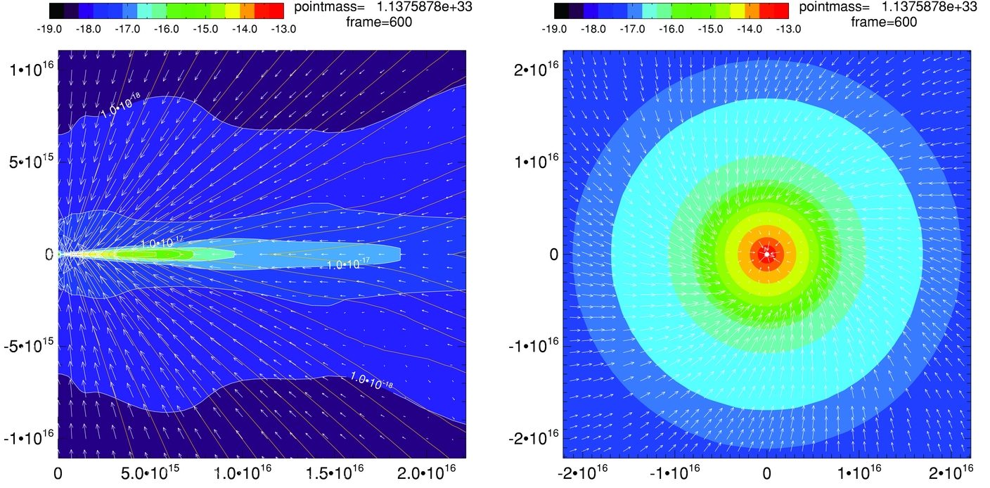
Magnetic braking catastrophe
Not rotationally supported!
Z.-Y. Li+2011

Slide 62
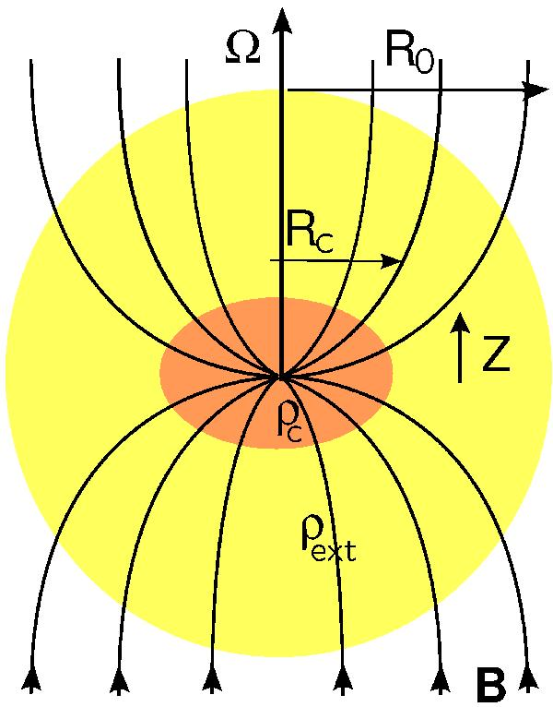
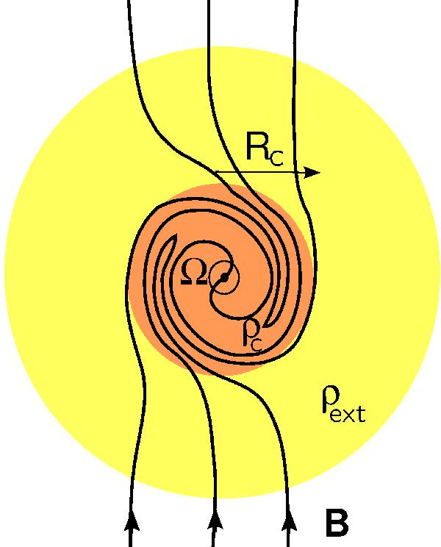
Magnetic braking catastrophe
Joos+2012
ALIGNED B-field & rotation
MORE magnetic braking
MISALIGNED B-field & rotation
LESS magnetic braking

Slide 63
LO-POL: B-fields ⟂ outflows
VLA 1623
L1527
IRAS 4B
B-field
Outflow
L1551 NE
Notes:
Other TADPOL future possibilities:
Intrinsic modeling of B-fields in cores (Fiege)
Constraints on B-fields in protoplanetary disks (Hughes)
Turbulence power spectra (Houde)
Larger scale background-star maps (Mimir, Jameson/Pillai/Clemens)

Slide 64
HI-POL vs. LO-POL: open questions
HI-POL
Are they younger?
Or have stronger B-fields?
Is our view is just dominated by the global field?
If so, are the fields actually twisted at smaller scales?
LO-POL
Are they older?
Or have weaker B-fields?
Are the twisted B-fields we see at 1000 AU consistent with B-fields at disk scales?

Slide 65
FUTURE multi-scale comparison: B-fields
?
1 pc
0.1 pc
1000 AU
100 AU
Machida+ 2006
180 AU
CARMA/SMA +
ALMA

Slide 66
Outline
Magnetized star formation
B-fields vs. outflows: multi-scale comparisons
Outflows/jets/disks and B-fields are randomly aligned (or perhaps ⟂?)
TADPOL survey
CARMA 1mm full-Stokes polarization system
B-fields: multi-scale comparisons
Cloud → core → envelope → disk
Two populations of cores: high and low polarization fraction
Back to outflows!
Disk formation implications
Star-forming regions

Slide 67
Alignment vs. polarization fraction
• Core
⨉ Star-forming region
90º
Hull+ 2013b (in prep)
SFRs
𝜽_{small} – 𝜽_{large} (deg)
45º
0º
Polarization %
1%
7%

Slide 68
Star-forming regions
DR21(OH)
Notes:
Other TADPOL future possibilities:
Intrinsic modeling of B-fields in cores (Fiege)
Constraints on B-fields in protoplanetary disks (Hughes)
Turbulence power spectra (Houde)
Larger scale background-star maps (Mimir, Jameson/Pillai/Clemens)

Slide 69
Star-forming regions
DR21(OH)
Notes:
Other TADPOL future possibilities:
Intrinsic modeling of B-fields in cores (Fiege)
Constraints on B-fields in protoplanetary disks (Hughes)
Turbulence power spectra (Houde)
Larger scale background-star maps (Mimir, Jameson/Pillai/Clemens)

Slide 70
Star-forming regions
NGC 7538
Notes:
Other TADPOL future possibilities:
Intrinsic modeling of B-fields in cores (Fiege)
Constraints on B-fields in protoplanetary disks (Hughes)
Turbulence power spectra (Houde)
Larger scale background-star maps (Mimir, Jameson/Pillai/Clemens)

Slide 71
Star-forming regions
NGC 7538 IRS 1
Notes:
Other TADPOL future possibilities:
Intrinsic modeling of B-fields in cores (Fiege)
Constraints on B-fields in protoplanetary disks (Hughes)
Turbulence power spectra (Houde)
Larger scale background-star maps (Mimir, Jameson/Pillai/Clemens)

Slide 72
Star-forming regions
W3(OH)
Notes:
Other TADPOL future possibilities:
Intrinsic modeling of B-fields in cores (Fiege)
Constraints on B-fields in protoplanetary disks (Hughes)
Turbulence power spectra (Houde)
Larger scale background-star maps (Mimir, Jameson/Pillai/Clemens)

Slide 73
Star-forming regions
W3(OH)
Notes:
Other TADPOL future possibilities:
Intrinsic modeling of B-fields in cores (Fiege)
Constraints on B-fields in protoplanetary disks (Hughes)
Turbulence power spectra (Houde)
Larger scale background-star maps (Mimir, Jameson/Pillai/Clemens)

Slide 74
Star-forming regions
W3 Main
Notes:
Other TADPOL future possibilities:
Intrinsic modeling of B-fields in cores (Fiege)
Constraints on B-fields in protoplanetary disks (Hughes)
Turbulence power spectra (Houde)
Larger scale background-star maps (Mimir, Jameson/Pillai/Clemens)

Slide 75
Star-forming regions
W3 Main
Notes:
Other TADPOL future possibilities:
Intrinsic modeling of B-fields in cores (Fiege)
Constraints on B-fields in protoplanetary disks (Hughes)
Turbulence power spectra (Houde)
Larger scale background-star maps (Mimir, Jameson/Pillai/Clemens)

Slide 76
Summary
B-fields are either preferentially misaligned (perp.) or randomly aligned with respect to outflows at the ~1000 AU scale
Thus, circumstellar disks are misaligned with fields in the cores from which they formed
High-pol sources: consistent large- to small-scale B-fields
Yet, outflows and B-fields are randomly misaligned
Global field doesn’t affect final angular momentum
Low-pol sources: inconsistent large- to small-scale B-fields
Outflows and B-fields are perpendicular
Could aid in disk formation
Questions:
Why are B-fields and outflows randomly aligned?
What will disk-scale B-field measurements show?
TADPOL outflows vs. B-fields: ApJ, 768, 159
TADPOL survey (CARMA key project): tadpol.astro.illinois.edu
Notes:
Other TADPOL future possibilities:
Intrinsic modeling of B-fields in cores (Fiege)
Constraints on B-fields in protoplanetary disks (Hughes)
Turbulence power spectra (Houde)
Larger scale background-star maps (Mimir, Jameson/Pillai/Clemens)

Slide 77
Fin

Slide 78
EXTRA SLIDES

Slide 79
Cores with consistent large-to-small B-fields
OMC3-MMS6
Notes:
Other TADPOL future possibilities:
Intrinsic modeling of B-fields in cores (Fiege)
Constraints on B-fields in protoplanetary disks (Hughes)
Turbulence power spectra (Houde)
Larger scale background-star maps (Mimir, Jameson/Pillai/Clemens)

Slide 80
TADPOL results – high mass
OMC3-MMS6
Notes:
Other TADPOL future possibilities:
Intrinsic modeling of B-fields in cores (Fiege)
Constraints on B-fields in protoplanetary disks (Hughes)
Turbulence power spectra (Houde)
Larger scale background-star maps (Mimir, Jameson/Pillai/Clemens)

Slide 81
Cores with consistent large-to-small B-fields
OMC3-MMS5/6
Notes:
Other TADPOL future possibilities:
Intrinsic modeling of B-fields in cores (Fiege)
Constraints on B-fields in protoplanetary disks (Hughes)
Turbulence power spectra (Houde)
Larger scale background-star maps (Mimir, Jameson/Pillai/Clemens)

Slide 82
Star-forming regions
Orion KL
Notes:
Other TADPOL future possibilities:
Intrinsic modeling of B-fields in cores (Fiege)
Constraints on B-fields in protoplanetary disks (Hughes)
Turbulence power spectra (Houde)
Larger scale background-star maps (Mimir, Jameson/Pillai/Clemens)

Slide 83
Star-forming regions
Orion KL
Notes:
Other TADPOL future possibilities:
Intrinsic modeling of B-fields in cores (Fiege)
Constraints on B-fields in protoplanetary disks (Hughes)
Turbulence power spectra (Houde)
Larger scale background-star maps (Mimir, Jameson/Pillai/Clemens)

Slide 84
TADPOL results – high mass
OMC2-FIR4
Notes:
Other TADPOL future possibilities:
Intrinsic modeling of B-fields in cores (Fiege)
Constraints on B-fields in protoplanetary disks (Hughes)
Turbulence power spectra (Houde)
Larger scale background-star maps (Mimir, Jameson/Pillai/Clemens)

Slide 85
TADPOL results – high mass
OMC2-FIR4
Notes:
Other TADPOL future possibilities:
Intrinsic modeling of B-fields in cores (Fiege)
Constraints on B-fields in protoplanetary disks (Hughes)
Turbulence power spectra (Houde)
Larger scale background-star maps (Mimir, Jameson/Pillai/Clemens)

Slide 86
Upper limits on circumstellar disk polarization
CARMA + SMA results
Disks are not strongly polarized at ~100 AU scales:
Hughes, Hull, Wilner, & Plambeck 2013, AJ, 145, 115
Notes:
Tamura+99 – JCMT results
-Other sources: GM Aur, MWC 480

Slide 87
Implications for disk formation
Weak & misaligned B-fields in cores could aid disk formation
Addresses “magnetic braking catastrophe”
Points are from simulations in Joos+ 2012
We find that ~10–50% of Class 0/I stars should form Keplerian disks
cos( 𝛉 between B-field & disk axis )
Flux-to-mass ratio
Krumholz, Crutcher, & Hull 2013, ApJL, 767, L11

Slide 88
Implications: disk formation
Joos, Hennebelle+Ciardi, Krumholz, Crutcher, & Hull
Magnetic braking catastrophe, & possible solution
B-fields may not be as dynamically important as we thought on small scales…but they’re still ordered, so something must be going on
L1527, Ser-emb 8: perp on SCUBA vs. CARMA scales…twisted at small scales in disk?
ALMA!

Slide 89
Other projects
Filamentary B-field structure in Serpens
Observing same field as ALMA (Mundy et al.)

Slide 90
Serpens CARMA+ALMA project
Grayscale: N2H+ from CLASSy

Slide 91
Serpens CARMA+ALMA project
Grayscale: N2H+ from CLASSy

Slide 92
Serpens CARMA+ALMA project

Slide 93
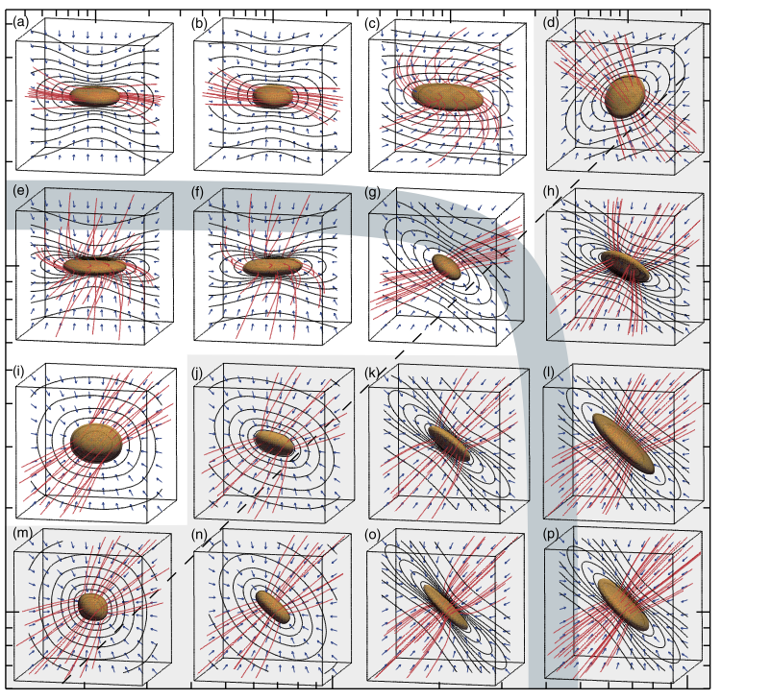
Achieving (mis)alignment: simulations
Machida+ 2006
Faster core rotation → →
Stronger B-field → →
Notes:
McKEE SAYS: initial misalignments could be from turbulence; his simulations drive turb at scales of ~0.5 pc
-He seems misalignment with angmom and ambient B-field
-INTERPLAY BETWEEN U_rot, U_grav, and U_B!
-y-axis: rot. rate / free-fall time
-x-axis: sqrt [ B-pressure / thermal pressure ]
-These started with 45º obliquity
-When magnetically dominated, core B-field and outflow line up
-When rotationally dominated, B-field can end up perp to outflow!
-Most cores tend to fall in the ~0.02 U_rot/U_grav area (Goodman et al. ‘93), but there are cores with a ratio of up to 1…

Slide 94
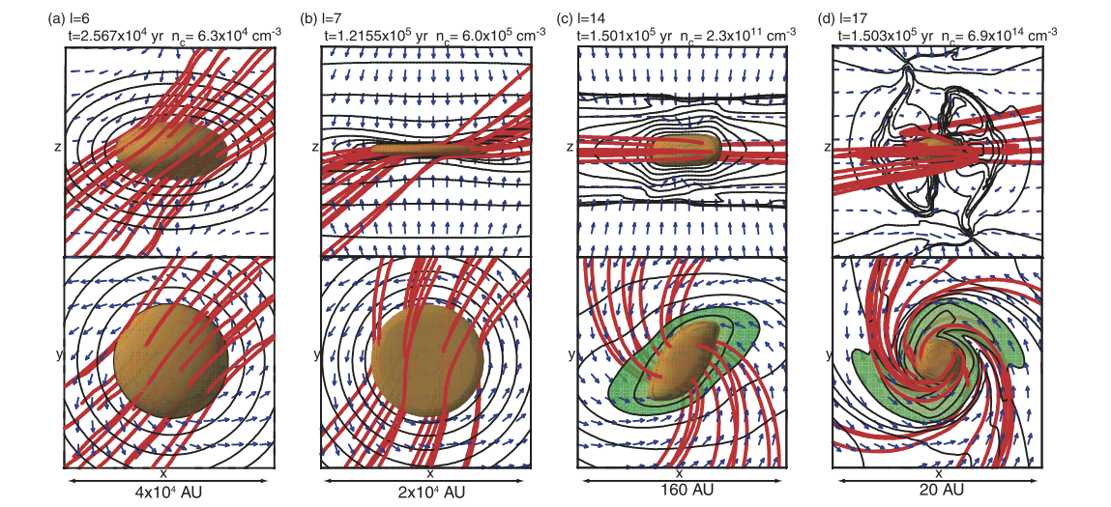
Outflow vs. B-field direction (simulations)
Machida+ 2006
Edge-on
Pole-on
2 pc
1 pc
0.0007 pc
(160 AU)
0.00001 pc
(20 AU)
CARMA →
CSO / JCMT
ALMA
At d = 500 pc, the D-array synthesized beam (at 1 mm) spans 2", or 0.005 pc (1000 AU)
Notes:
-THINGS AREN’T ALWAYS WHAT THEY SEEM: we always want to probe deeper!
-Things look aligned on larger scales, but they’re really not, on the smallest scales…
-ON WHAT SCALE DO THEY BECOME MISALIGNED?!
-Single-dish can see the larger scales
-ALMA can see the madd-tiny scales
-CARMA is relevant for probing the middle scales!!! (CARMA can also see madd-tiny scales, but we don’t have the sensitivity in full-Stokes mode)
-Simulations: 45º orientation, alpha of 0.01, omega of 0.5 (low field, high rotation)
-Rotationally dominant (simulation with high rotation and medium B-field parameters)– field gets wrapped up
-We can still only see on the 0.01 pc scale with CARMA
-In A-array, could see 100 AU, but have 100x less synth. beam area, and unless there’s a highly polarized point source (say, a 100 AU disk), we wouldn’t see anything

Slide 95
Achieving (mis)alignment
Notes on rotation/B-field misalignment:
Weak B-field and strong rotation could cause misalignment
(Machida+06)
Turbulence may cause initial misalignment at
scales of ~0.1 pc (McKee)
Misalignment may be necessary for disk formation
(Joos+ ‘12, Li+ ’11, Hennebelle & Ciardi ’09)
?
Notes:
McKEE SAYS: initial misalignments could be from turbulence; his simulations drive turb at scales of ~0.5 pc
-He seems misalignment with angmom and ambient B-field
-INTERPLAY BETWEEN U_rot, U_grav, and U_B!
-y-axis: rot. rate / free-fall time
-x-axis: sqrt [ B-pressure / thermal pressure ]
-These started with 45º obliquity
-When magnetically dominated, core B-field and outflow line up
-When rotationally dominated, B-field can end up perp to outflow!
-Most cores tend to fall in the ~0.02 U_rot/U_grav area (Goodman et al. ‘93), but there are cores with a ratio of up to 1…

Slide 96
How do we get misalignment?
Grain alignment (Gold alignment, anomalous grain orientation)
Outflow feedback (should be bimodal)
Rotation (should be bimodal)
Extreme hourglass (should be bimodal)

Slide 97
Star formation…with B-fields
Galli & Shu 1993a

Slide 98
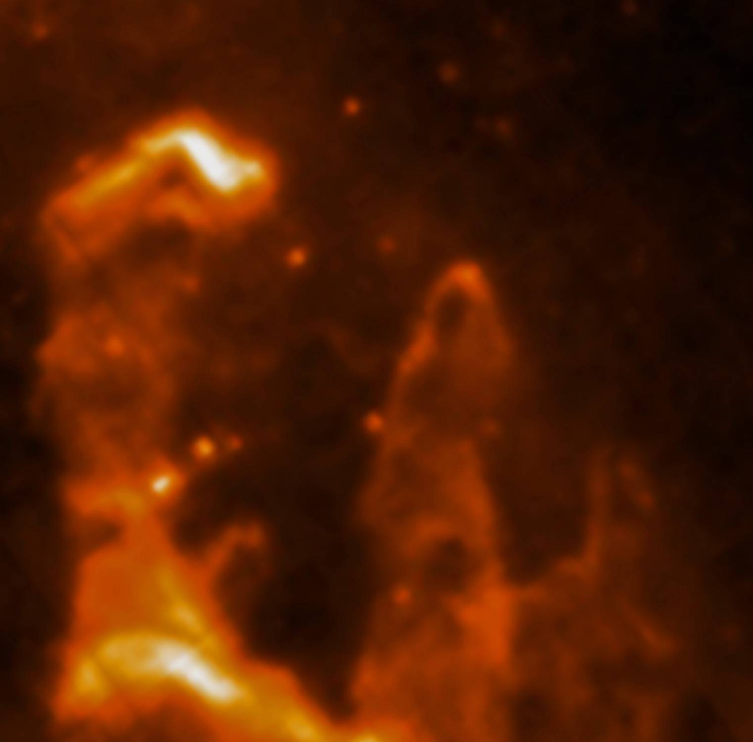
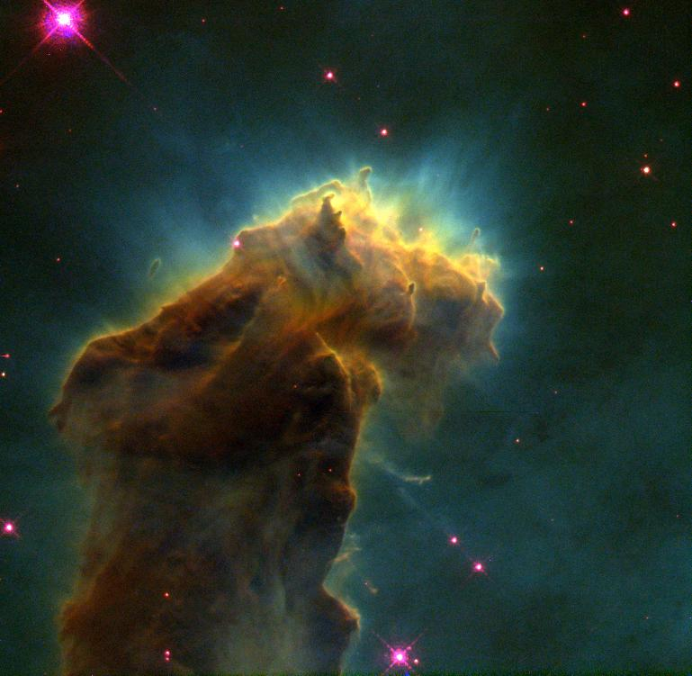
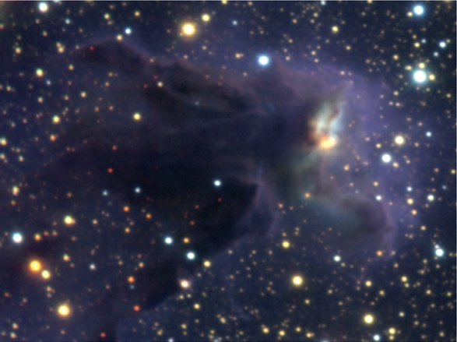
Star Formation
0.5 pc
Credit:
Optical: NASA, ESA, STScI, J. Hester and P. Scowen (Arizona State University)
NIR: ESO/M. McCaughrean & M. Anderson (AIP)
MIR: ESA/Herschel/PACS/SPIRE/Hill, Motte, HOBYS Key Programme Consortium
Notes:
Eagle Nebula (M16)
-There’s actually HIGH-mass SF going on (glowing, evaporating)
-We, however are going to journey inside to look at low-mass forming stars: Class 0s, in particular (rising SED between 2 & 8 microns)

Slide 99
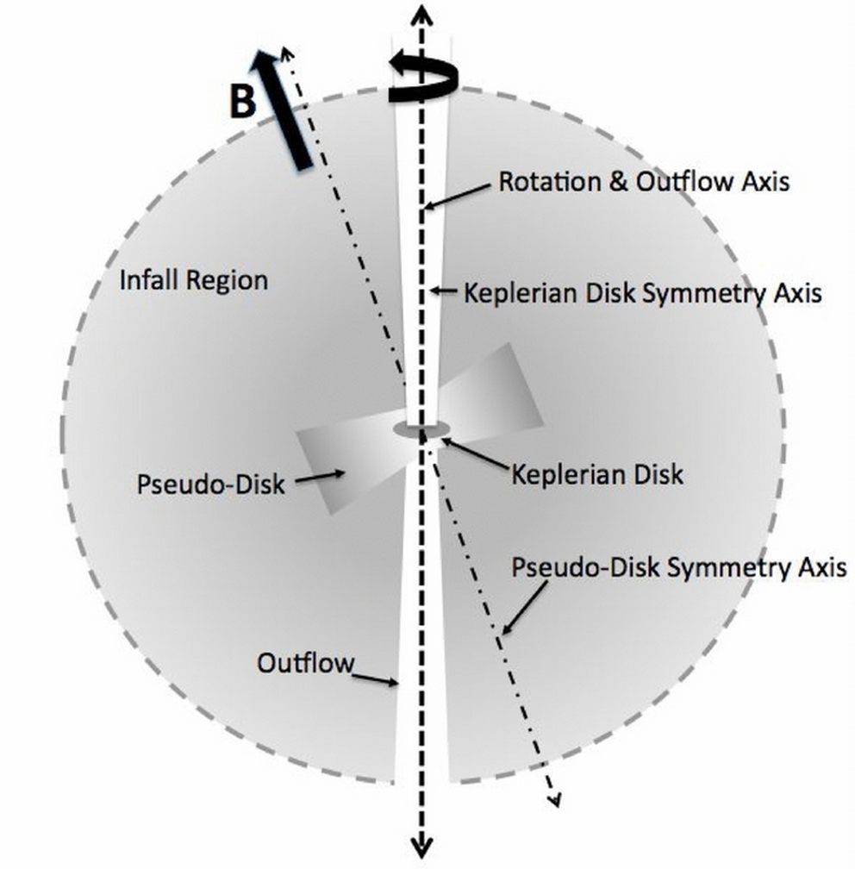
Star formation…with B-fields
Keplerian disk
100 AU
Dense core
10⁴ AU
(~0.1 pc)
“Pseudodisk”
1,000 AU
Davidson+ 2011
Notes:
-Collapsing envelope
-Magnetically supported, collapsing “pseudodisk”
-Keplerian (rotationally supported…?) disk in the middle, aligned with rotation & outflow
-Ang mom can be thrown out by torsional Alfven waves in the outflow…that’s sort of the same thing as spreading angular momentum outward by magnetic braking

Slide 100
HARDWARE SLIDES

Slide 101
1 mm dual-polarization receivers
SIS mixers
Orthomode transducer
Waveguide circular polarizer
1 inch
WBA13
I.F. amplifiers (1-9 GHz)
Credit: Dick Plambeck
Notes:
-Sensitive to RCP & LCP
-Null experiment: in the absence of linear polarization, you get no RL correlation at any time.
-If you have linear feeds, you have XY correlation sometimes (when the intrinsic polarization is at 45º to your two feeds), and not other times (when it’s along one feed or the other). Thus, to tease out the polarization, you need stable gains

Slide 102
1 mm dual-polarization receivers
Waveguide circular polarizer
1 inch
Credit: Dick Plambeck
Notes:
-Sensitive to RCP & LCP
-Null experiment: in the absence of linear polarization, you get no RL correlation at any time.
-If you have linear feeds, you have XY correlation sometimes (when the intrinsic polarization is at 45º to your two feeds), and not other times (when it’s along one feed or the other). Thus, to tease out the polarization, you need stable gains

Slide 103
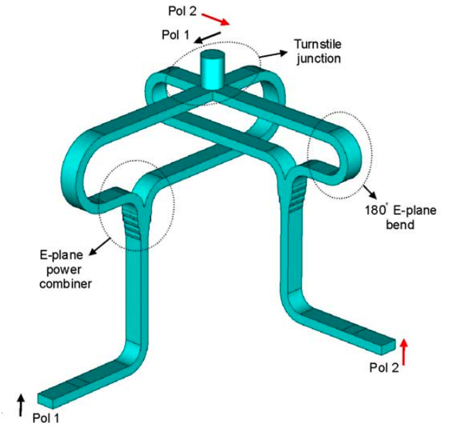
Turnstile-junction OMT
1 cm
Navarrini & Plambeck 2006, IEEE-MTT, 54, 272-277
Notes:
The OMT is based on a turnstile junction and 2 power combiners - this design was worked out by Alessandro Navarrini when he was a postdoc in Berkeley.
It looks pretty intimidating to make, but it’s not as bad as it looks . The waveguides are all split down the middle, so what you have do do is to machine 4 blocks of metal and bolt them together.

Slide 104
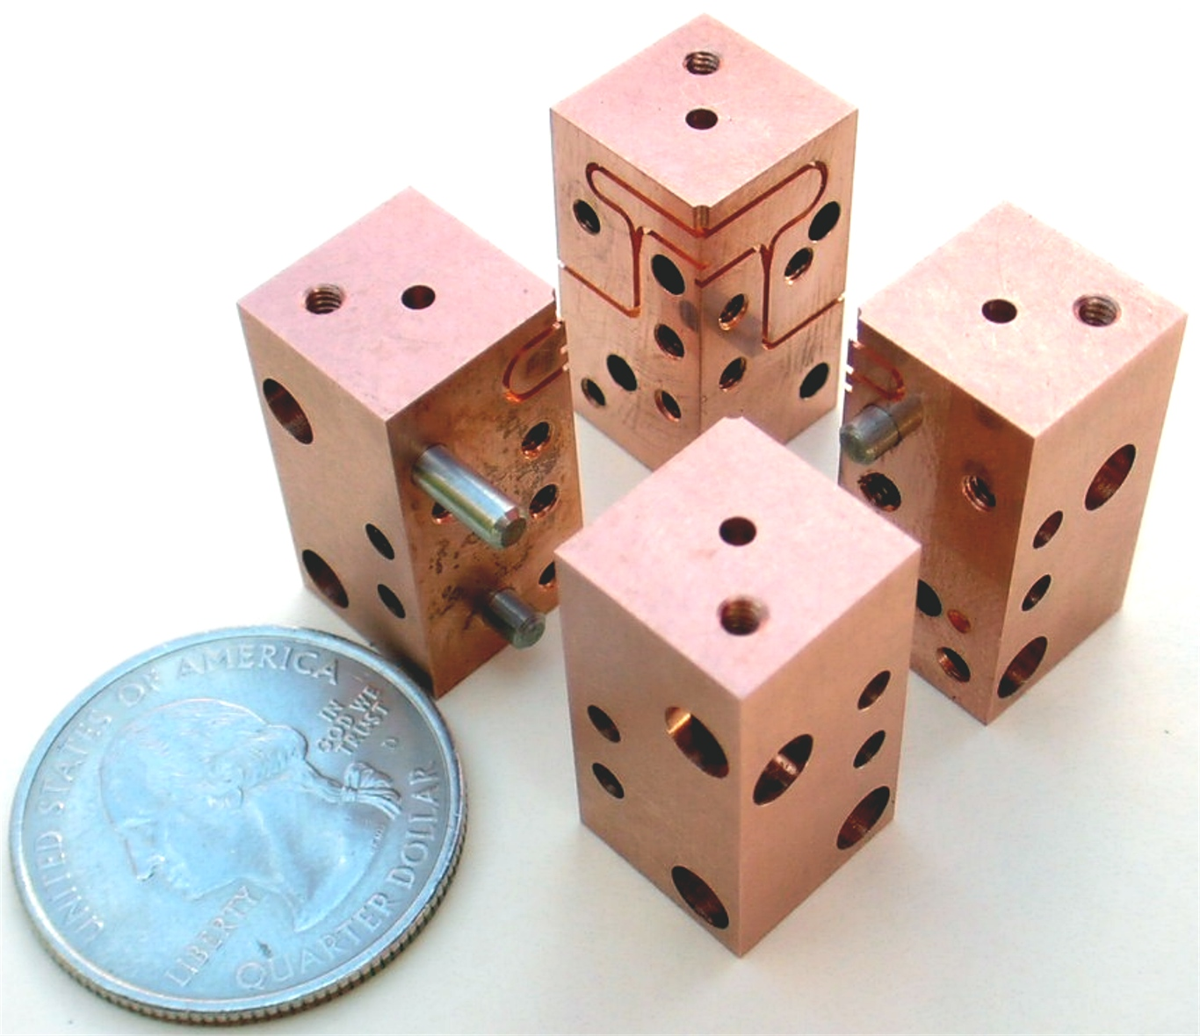
OMT construction
Notes:
Here’s an assembly diagram.
Now, as you know, it’s not so hard to get great results out of an electromagnetic simulation of a device like this, but can you actually machine it reproducibly?

Slide 105
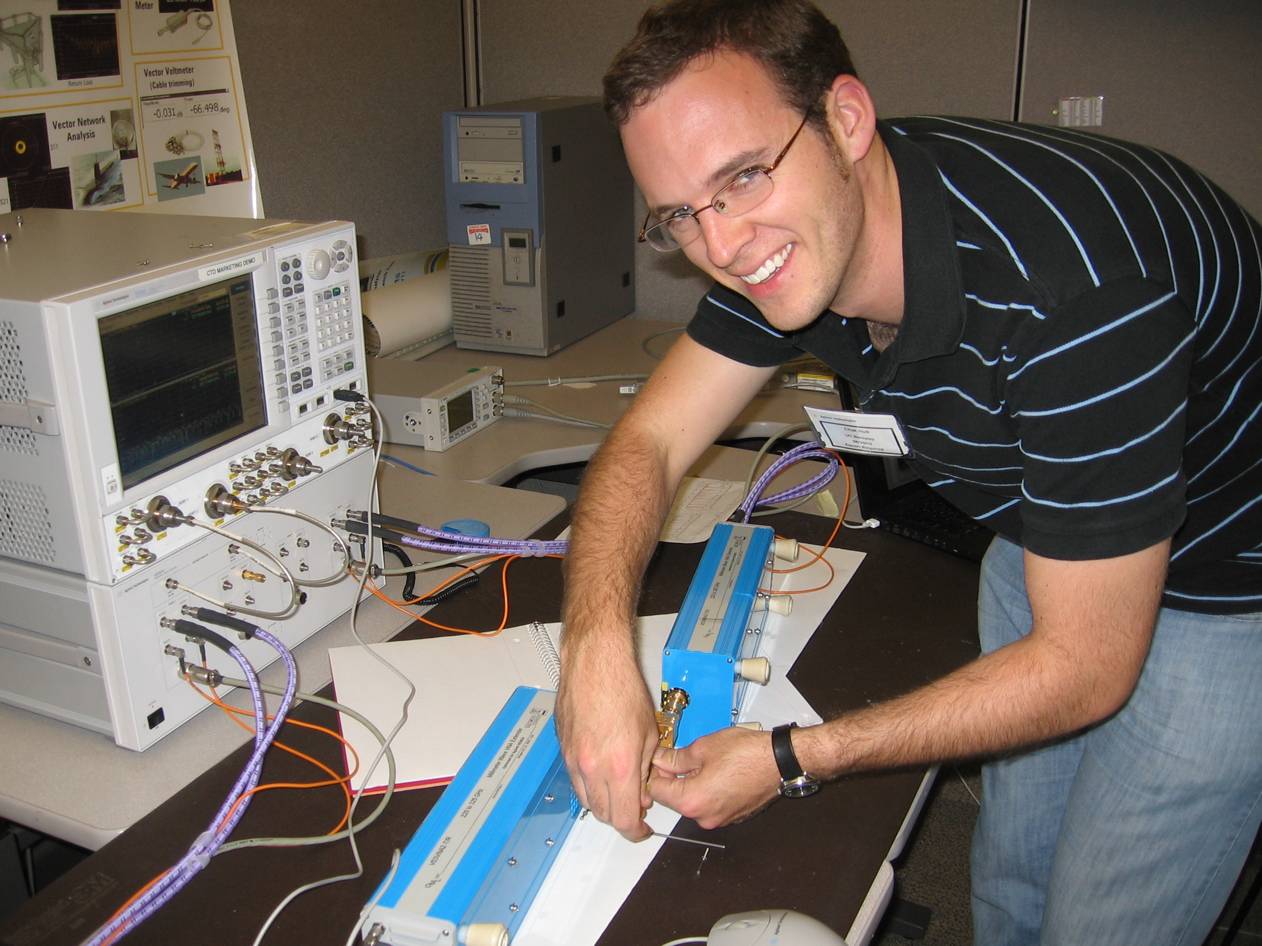
Testing OMTs using 300 GHz network analyzer at Agilent

Slide 106
Some OMTs have resonances…

Slide 107
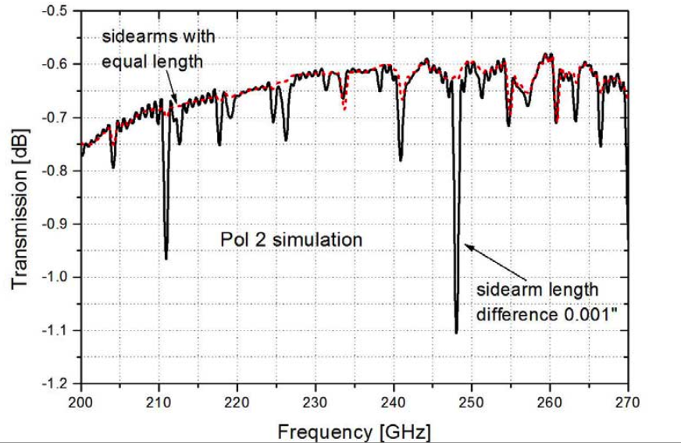
Unequal sidearm lengths in OMT can cause resonances (simulation)

Slide 108
OMT tests at 4K (passbands, LO = 210-255 GHz in 1 GHz steps)
OMT10 (bad)
OMT15 (good)

Slide 109
2-section polarizer
λ/2 retarder
at 15°
λ/4 retarder
at 74.5°
Plambeck & Engargiola, CARMA Memo #54
Notes:
-Chose waveguide design because it can be integrated into the receiver (in the cold part), and thus doesn’t create loss the way a room-temperature quarter-wave plate does.

Slide 110
R L → → →
Polarizer simulation
← Feed horn (sky)
OMT →
Sky
Receiver
Plambeck & Engargiola, CARMA Memo #54
RCP
X
LCP
Y
Credit: Greg Engargiola
Y
X
Notes:
These are effectively quarter-wave plates.

Slide 111
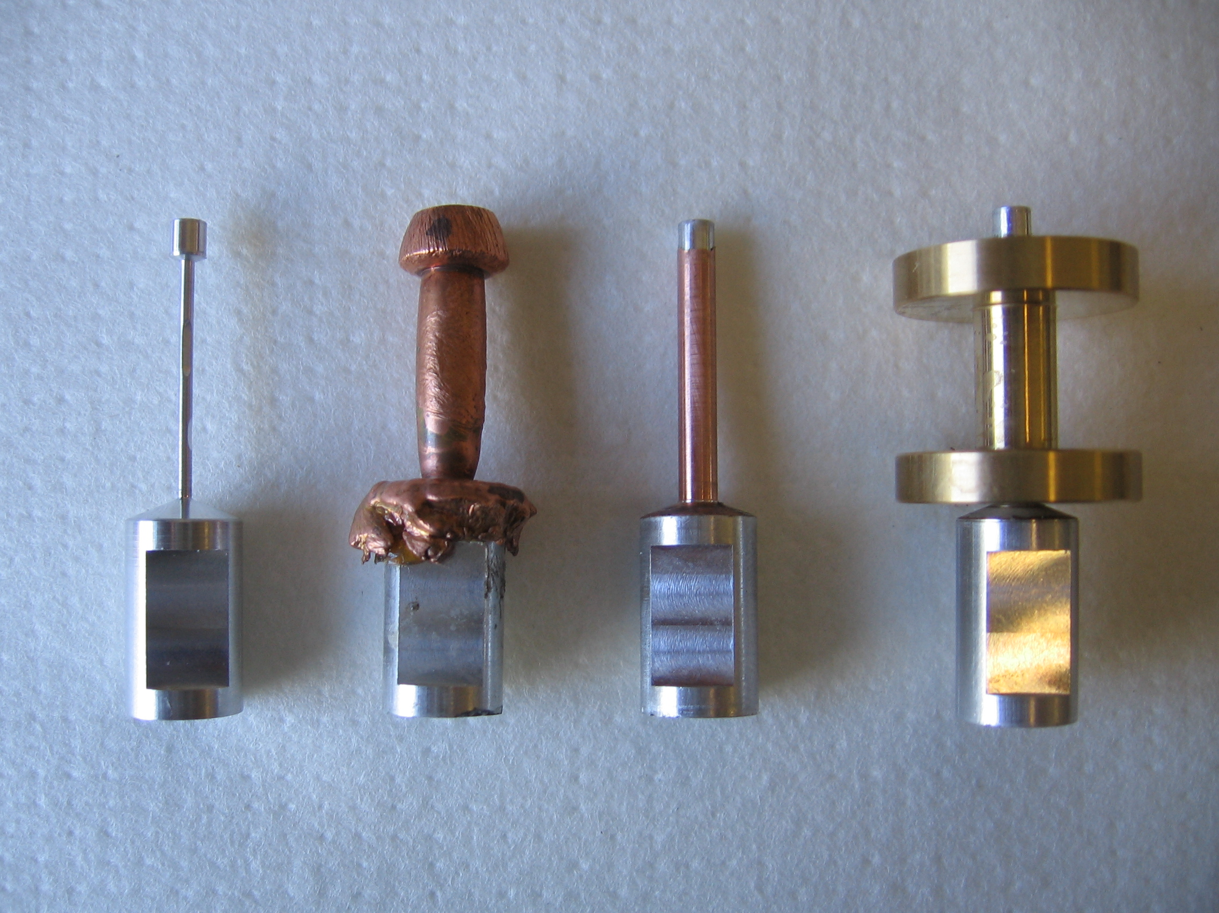
Polarizer construction
Aluminum
mandrel
Copper electroplated onto mandrel
Machined
Soldered into waveguide flange
1 inch

Slide 112
Sample polarizer test data (mandrel machining errors)
Fraction of linear radiation converted to RCP and LCP

Slide 113
Polarization calibration
Two main steps to calibrate a polarimeter:
XY phase
The absolute phase offset between the RCP and LCP receivers of an antenna
Leakage terms
The fraction of LCP radiation detected in the RCP receiver, and vice versa

Slide 114
XY phase calibration
How do we find an antenna’s XY phase?
Observe a strongly polarized source with known position angle
These don’t exist at mm wavelengths
We create our own by observing broadband noise from the ambient load through a wire-grid polarizer!

Slide 115
Stokes parameters, for circular polarization
Notes:
RR &= I + V \\
LL &= I - V \\
RL &= Q + iU \\
LR &= Q – iU
I &= RR + LL \\
Q &= RL + LR \\
iU &= RL - LR \\
V &= RR - LL

Slide 116
Polarization % and position angle uncertainties
NOTE:
The position angle is measured counterclockwise from North
A 3-sigma Q,U detection gives you an uncertainty of ~10º
p_{db} is the debiased polarization (see Vaillancourt 2006)
Notes:
3-sigma hypot(Q,U)/rms_QU → 10º uncertainty
6-sigma, 5º, etc.
p &= \sqrt{Q^2 + U^2} \\
\delta p &= p^{-1} \sqrt{Q^2 \, \delta U^2 + U^2 \, \delta Q^2 } \\
p_{\rm{db}} &= \sqrt{p^2 - \delta p^2} \\
\% &= \frac{p_{\rm{db}} \pm \delta p}{I} \times 100\% \\ \\
\chi &= \frac{1}{2} \arctan\left(\frac{U}{Q}\right) \\
\delta \chi &= \frac{1}{2} \frac{\delta p}{p_{\rm{db}}} \\

Slide 117
XY phase calibration
SKY (~60 K)
WIRE-GRID POLARIZER
AMBIENT LOAD
(300 K)
FEED HORN
Notes:
-Extremely high percentage polarization, thus…
-High-SNR correlation between LCP and RCP.
-Band dependent due to hardware
-Antenna dependent
-Forward gains of antennas: 100 Jy/K (10m), 150 Jy/K (6m)
-Sky temperature calculation: atmosphere temp*(1 – \e^{-\tau}), or (280 K)*(1 – e^(-0.2)) = ~50 K for typical weather

Slide 118
XY phase fit results
Notes:
Tau_2: overall slope across IF. Tau_3_hi,lo: intra-band slopes. Tau_4: jumps and equal-and-opposite slopes in higher and lower chunks.

Slide 119
1 mm signal path
RF = 210 – 270 GHz
IF = 1 – 9 GHz
Baseband = 0.5 – 1.0 GHz
τ₂
10 GHz mixer
τ_{3,hi}
τ₁
Baseband mixer
RF mixer
5 – 9 GHz
1 – 5 GHz
FILTER
FILTER
To digitizer, filter,
& correlator
RCP
1 – 9 GHz
0.5 – 1.0 GHz
FILTER
1 – 5 GHz
τ₄
Feed horn
τ_{3,lo}
Polarizer
OMT
Block
downconverters
All phases flat
LO 2
NOISE
8-way splitters
1.75 – 4.25 GHz
Correlated Noise Source
5 – 9 GHz
1 – 5 GHz
FILTER
FILTER
To digitizer, filter,
& correlator
LCP
1 – 9 GHz
0.5 – 1.0 GHz
FILTER
1 – 5 GHz
Notes:
We fit these delays to Xyphase data at a variety of IF setups.

